Slide 1
FOURTH NORMAL FORM

Slide 2
The Fourth Normal Form (4NF) is a level of database normalization where there are no non-trivial multivalued dependencies other than a candidate key.
It builds on the first three normal forms (1NF, 2NF, and 3NF) and the Boyce-Codd Normal Form (BCNF).
It states that, in addition to a database meeting the requirements of BCNF, it must not contain more than one multivalued dependency.

Slide 3

Properties
A relation R is in 4NF if and only if the following conditions are satisfied:
A table with a multivalued dependency violates the normalization standard of the Fourth Normal Form (4NF) because it creates unnecessary redundancies and can contribute to inconsistent data.
To bring this up to 4NF, it is necessary to break this information into two tables.
Example: Consider the database table of a class that has two relations R1 contains student ID(SID) and student name (SNAME) and R2 contains course id(CID) and course name (CNAME).

Slide 4
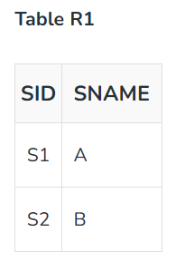
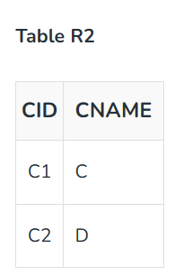
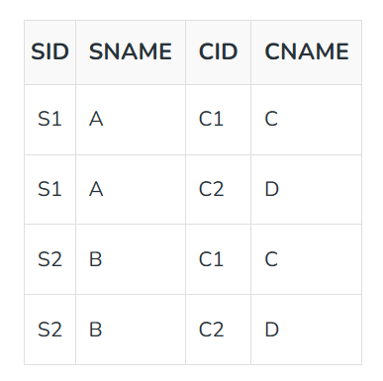
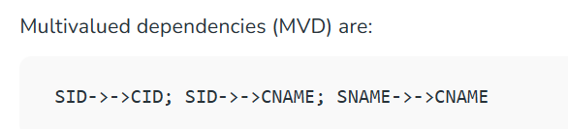
When their cross-product is done it resulted in multivalued dependencies.
Table R1 X R2

Slide 5
Joint Dependency
Join decomposition is a further generalization of Multivalued dependencies.
If the join of R1 and R2 over C is equal to relation R then we can say that a join dependency (JD) exists, where R1 and R2 are the decomposition R1(A, B, C) and R2(C, D) of a given relations R (A, B, C, D).
Alternatively, R1 and R2 are a lossless decomposition of R. A JD ⋈ {R1, R2, …, Rn} is said to hold over a relation R if R1, R2, ….., Rn is a lossless-join decomposition.
The *(A, B, C, D), (C, D) will be a JD of R if the join of joins attribute is equal to the relation R.
Here, *(R1, R2, R3) is used to indicate that relation R1, R2, R3 and so on are a JD of R. Let R is a relation schema R1, R2, R3……..Rn be the decomposition of R. r( R ) is said to satisfy join dependency if and only if

Slide 6
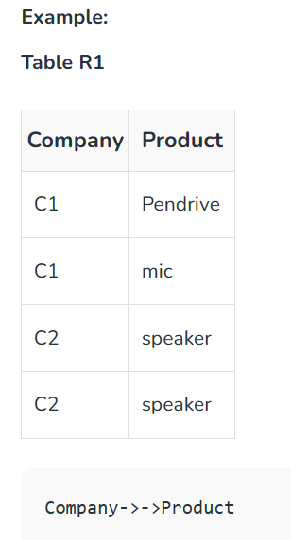
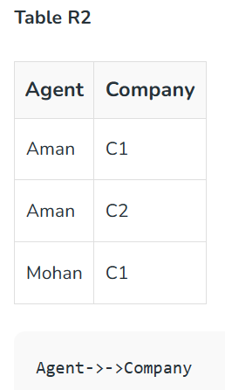
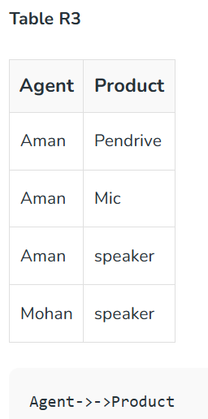

Slide 7
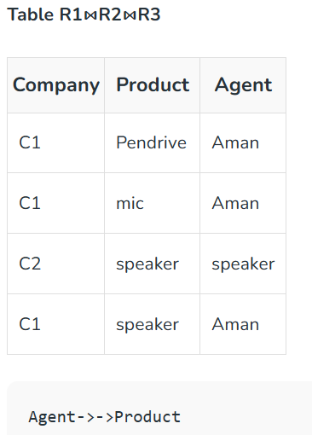

Slide 8
Fifth Normal Form / Projected Normal Form (5NF)
A relation R is in Fifth Normal Form if and only if everyone joins dependency in R is implied by the candidate keys of R.
A relation decomposed into two relations must have lossless join Property, which ensures that no spurious or extra tuples are generated when relations are reunited through a natural join.
Properties
A relation R is in 5NF if and only if it satisfies the following conditions:

Slide 9
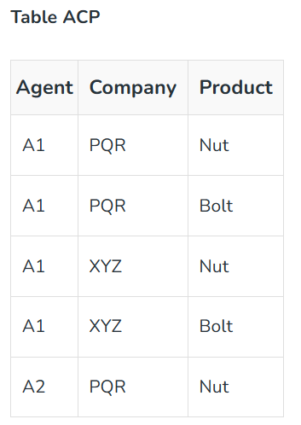
Example – Consider the above schema, with a case as “if a company makes a product and an agent is an agent for that company, then he always sells that product for the company”. Under these circumstances, the ACP table is shown as:
The relation ACP is again decomposed into 3 relations.
Now, the natural Join of all three relations will be shown as:

Slide 10
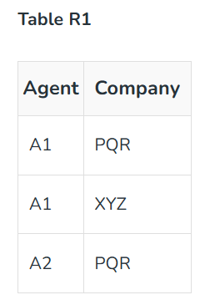
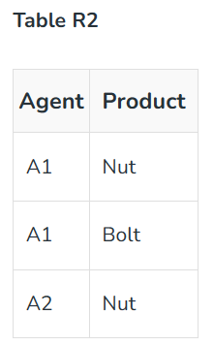
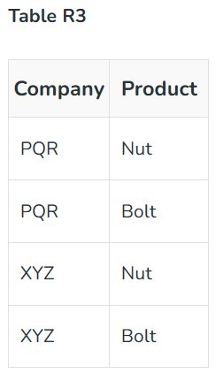
The result of the Natural Join of R1 and R3 over ‘Company’ and then the Natural Join of R13 and R2 over ‘Agent’and ‘Product’ will be Table ACP.
Hence, in this example, all the redundancies are eliminated, and the decomposition of ACP is a lossless join decomposition.
Therefore, the relation is in 5NF as it does not violate the property of lossless join.

